Slide 1
SHS LRCII Remote Learning For the week of May 26th
Welcome to our online classroom!
This PowerPoint has been set up for you for the week of May 26th^{th}!

Slide 2
Instructions for Caregivers:
The following daily schedule is intended to run for 3-4 hours (example might be 8am -12pm.) You may run the schedule in it’s entirety or do the pieces you are comfortable with. If you would like a longer learning at home schedule, please let me know and I can give you some options (run the schedule a second time or provide extension activities).

Slide 3
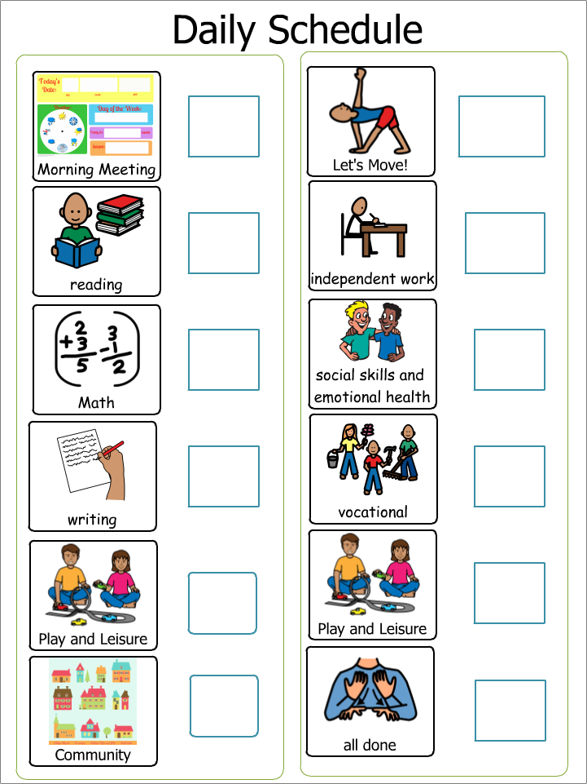
Daily Visual Schedule To make your own daily schedule: CLICK HERE

Slide 4
Morning Meeting/Student Check-In:
*This portion of our day is intended to last about 15 minutes. Please adjust your time based on your child’s needs and abilities.
Morning Meeting:
Do the Morning Meeting Boom Cards: CLICK HERE
Question of the Week:
Provided by SLP/OT (new every Thursday)
CLICK HERE

Slide 5
Teach Time:
Note to Caregivers: The following teach time is intended to last about 60 minutes total. These slides incorporate NEW learning based on your child’s Individual Education Plan (IEP). The following activities include Reading, Writing and Math. They may not exactly match their goals and objectives, but the content is matched as closely as possible. You can choose to do all three activities if you want to extend your child’s online school or choose one per day.
NOTE: CBI = Community Based Instruction

Slide 6
Reading Work: Work for 15 min, break for 5 min (You may also work for the full 20 minutes)
Please follow the links to sign in to your student’s work. Your student should read the book at least ONCE A DAY!
Monday NO SCHOOL | Tuesday Raz Plus BOOK: Assigned book (listen AND read) | Wednesday Raz Plus BOOK: Assigned book (read to partner) | Thursday Raz Plus BOOK: Assigned book (read to self) | Friday Quiz from your assigned book

Slide 7
Writing Work: Work for 15 min, break for 5 min (You may also work for the full 20 minutes)
Please follow the link to sign in to your student’s work.
Monday NO SCHOOL | Tuesday News 2 You Choose current story for News 2 You | Wednesday Raz Plus VOCABULARY: Assigned book (ONE activity) OR Finish N2Y story | Thursday Raz Plus VOCABULARY: Assigned book (TWO activities) OR Finish N2Y story | Friday Writing Boom Cards Title: Summarize by Sequence **have a story that you have read with you**

Slide 8
Math Work: Work for 15 min, break for 5 min (You may also work for the full 20 minutes)
Please follow the link to sign in to your student’s work.
Monday NO SCHOOL | Tuesday Go to link on Mrs. H's website Next Dollar Up, Adding Money, or Making Change | Wednesday Go to link on Mrs. H's website Next Dollar Up, Adding Money, or Making Change | Thursday Math Boom Cards Title: Choose 2 decks assigned to you | Friday QFC weekly Ad Go to the QFC Link (ABOVE): You have $20. Find 3 items you can buy on the weekly ad for $20.

Slide 9
Leisure Time:
Note to Parents: The following Leisure time is intended to last about 20 minutes. This portion of the schedule is to help your child engage in fun activities that can be done with support depending on your child’s needs and abilities.
Choose Activities that Interest your Child, the next slide is an example of a leisure choice menu.

Slide 11
Community:
Note to Caregivers: This portion of the daily schedule will incorporate accessing the community. It is intended to last 15 to 30 minutes, depending on the virtual field trip or video.
Monday NO SCHOOL | Tuesday A Day with a Police Officer | Wednesday Do you have what it takes? CBI Job Video: Police Officer | Thursday What you should know to become a police officer CBI Job Video: Police Officer | Friday Boom cards Title: Get a Job

Slide 12
Physical:
Note to Caregivers: This portion of the daily schedule will incorporate accessing some Physical Education. This is VOLUNTARY or access Mrs. Wince’s assignments for the week.
Monday NO SCHOOL | Tuesday Brain Gym With Ms. Natalia! | Wednesday Brain Gym | Thursday Brain Gym | Friday Brain Gym

Slide 13
Independent Work Time:
Note to Caregivers: The following teach time is intended to last about 60 minutes total. These slides incorporate work that the student has already mastered. You can choose to do all three activities if you want to extend your child’s online school or choose one per day.

Slide 14
Independent Writing Work: Work for 15 min, break for 5 min (You may also work for the full 20 minutes)
Please follow the link to sign in to your student’s work.
Typing
*Log in and Start Typing!

Slide 15
Independent Math Work: Work for 15 min, break for 5 min (You may also work for the full 20 minutes)
IF not working at this time, then choose Math Boom Cards or L3 Math Skills on individual student profiles
IXL
*Go to Recommendations
*Same Program All Week

Slide 16
Social Skills and Emotional Health:
Note to caregivers: The following time in the schedule is to focus on supporting your child’s social skills and emotional well being and is intended to last about 20 minutes.
Monday NO SCHOOL | Tuesday SLP/OT current lesson Microsoft TEAMS— Spartan Special Services and Remote Learning | Wednesday Social Skills-Boom cards Choose ONE social skills activity | Thursday Social Skills-Boom cards Choose TWO social skills activities | Friday Social Group with Class 12:30 pm

Slide 17
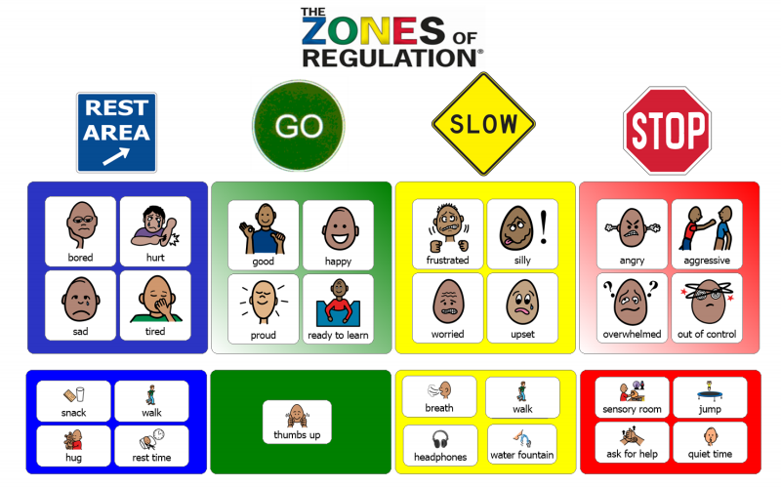
Extra Social Skills Practice:
Practice using this visual throughout your child’s day. Refer to this when they are calm and happy, getting frustrated or having challenging behaviors.

Slide 18
Vocational:
Note to Caregivers: This portion of the daily schedule will incorporate job skills or independent living skills.
Monday NO SCHOOL | Tuesday CBI Vocational Task VOCABULARY Go to link on Mrs. H's website | Wednesday Chores Make an emergency plan OR Write a thank you letter to a police officer | Thursday CBI Vocational Task WRITING PROMPT Go to link on Mrs. H's website | Friday Boom cards Title: Life Skills/Job Skills Complete the Order

Slide 19
Leisure Time:
Note to Parents: The following Leisure time is intended to last about 20 minutes. This portion of the schedule is to help your child engage in fun activities that can be done with support depending on your child’s needs and abilities.
Choose Activities that Interest your Child, the next slide is an example of a leisure choice menu.

Slide 21
Just for FUN!
Note to Caregivers: This portion of the daily schedule is “just for Fun” independent activities
Monday NO SCHOOL | Tuesday Boom Cards Title: What would you rather? | Wednesday L3 Skills Title: Build a Snowman Sequence | Thursday Boom Cards Title: Shipwreck-Spot the Difference | Friday L3 Skills Titles: Build-It FREEFORM Model Face, Aquarium, Train, Semi Truck, Rocket ship

Slide 22
Daily Check-OUT
Complete the Google document when you are done for the day! ☺
Daily Check-out
End of Week Check-out
Complete the Microsoft Form document on Friday
End of Week Assignment

Slide 23
You are all done with Online School Today!

